Slide 1
Extended GNSS
ASE 372N
Matthew Cullen Self
December 9, 2016

Slide 2
Feasibility of Using GPS in Space
Will my GPS receiver work on the moon?

Slide 3
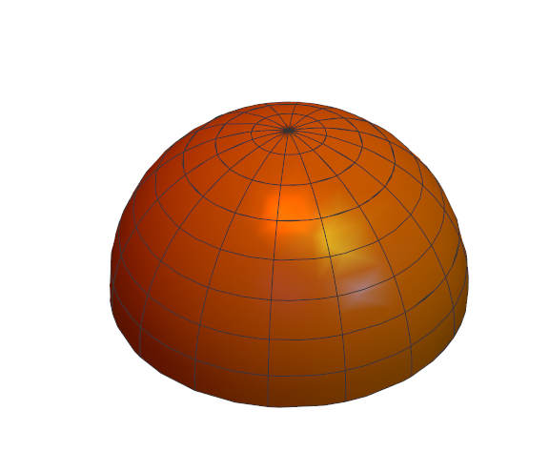
How GNSS SVs Broadcast
Antenna pointed at Earth
Emit a Hemisphere of Radio Waves
Most power in “Main Lobe”
“Side Lobes” still have some power
Notes:
Maybe add hemisphere graphic, or emitted power from SSV #19, cite GNSS satellite geometry and attitude models

Slide 4
Baseline
Classified Geosynchronous Satellite (42,164 km)
AMSAT-Oscar-40 (58,800 km)
GIOVE-A SGR-GEO (23,200 km)
MMS (76,000 km)
Notes:
Geosync – since 1990, not published how many SV tracked, entire signal is downlinked to process, included in nav model
Ao40 – launched 2000, not very powerful tracking, max of 2 sats tracked
GIOVE – launched 2005, Galileo test sat, onboard rx was able to produce nav sols with vdop 50-100m, hdop 10-15m (
MMS – launched 2015, has Navigator receiver - tracked at least 4 sats all the time
Cite: ssv, gps2000 [kronman], ao40, gps receiver dem 2007

Slide 5
Process
Can I test without going to the moon?

Slide 6
Quality of the Receiver
Antenna
Noise
Gain
Tracking Algorithm

Slide 7


Governing Equations
Notes:
Intro unbiased cn0

Slide 8
Data Sources
Gain patterns of GPS Block IIR & IIR(M) SVs (Lockheed Martin)
GNSS Attitude Models (Montenbruck)
Notes:
Given in terms of offbore sight theta, and clock angle phi
Cite GPS Block… Marquis
Cite montenbruck

Slide 9
Assumptions
All SVs are similar
SVs nominally emit 30 dBW of power
Receiver has uniform gain

Slide 10
Results

Slide 11
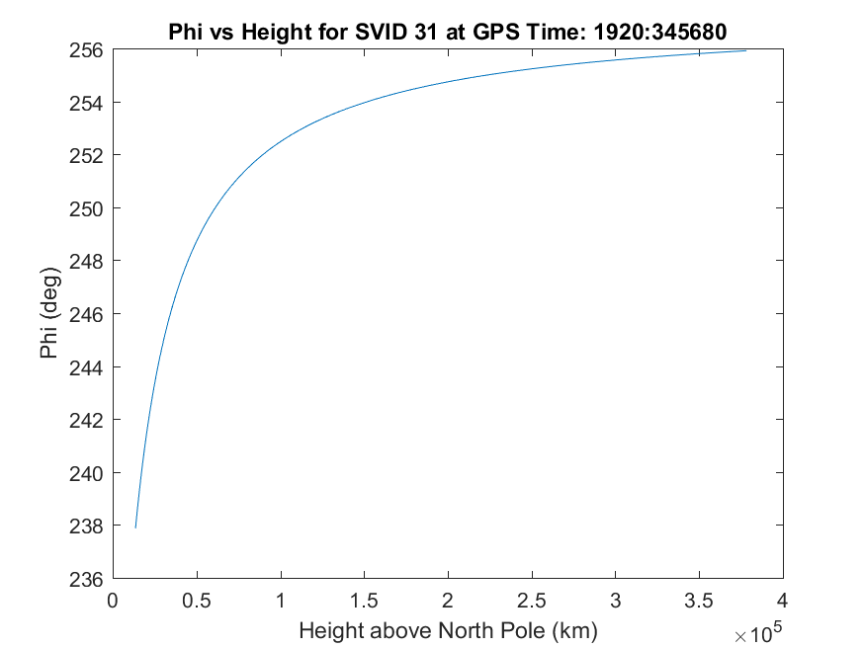
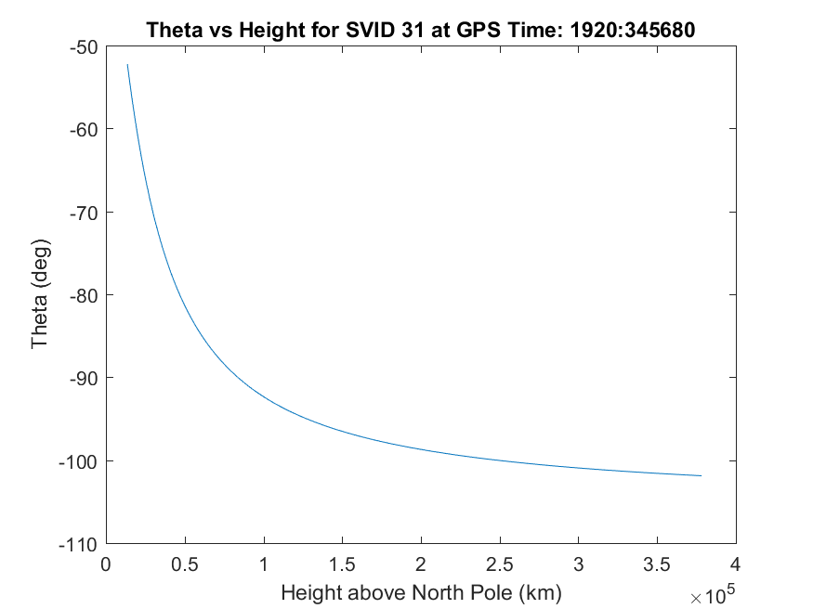
Single SV
Notes:
Actual sv location at given time, but modeled observer location above north pole

Slide 12
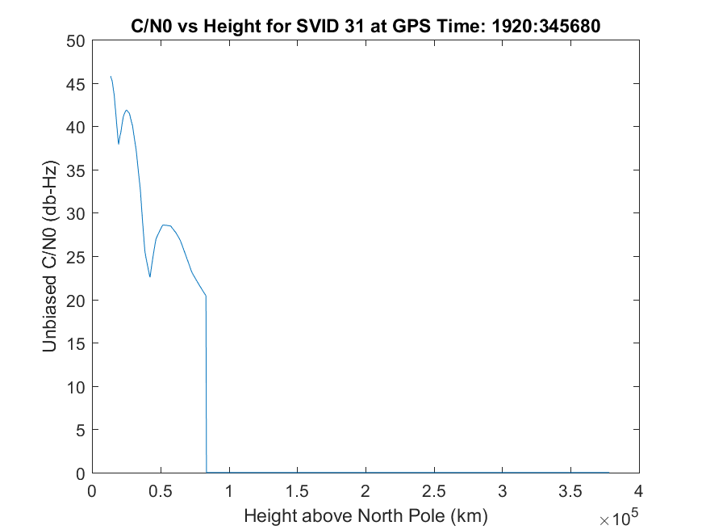
Single SV
Notes:
Note drop off corresponding to when theta>90 on previous slide

Slide 13
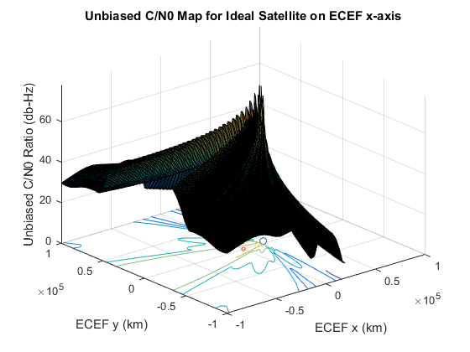
Single SV
Notes:
Unbiased c/n0 – not accounting for rxgain or rxnoise or thermal noise

Slide 14
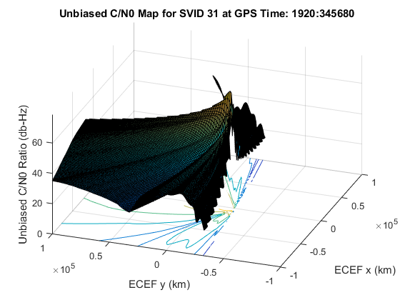
Single SV

Slide 15
Many SVs

Slide 16
DOP

Slide 17
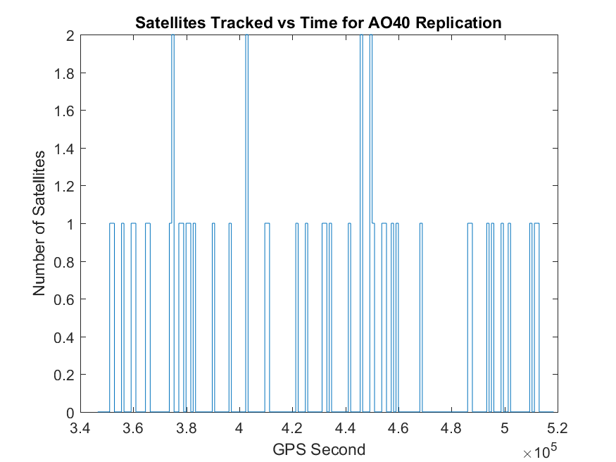
AO40 Replication
Notes:
0.24 sats on average – every 15 mins, threshold = 40 dbHz

Slide 18
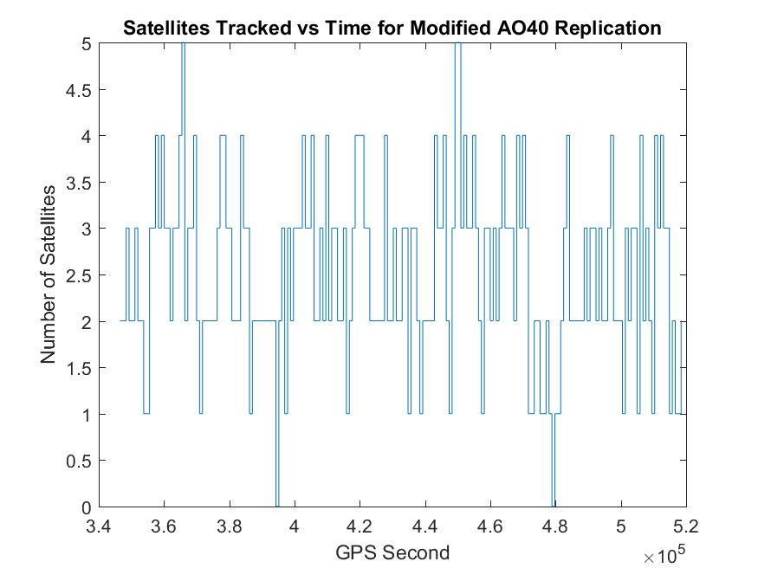
AO40 Replication
Notes:
2.5 sats on average, lowered threshold to 25 dbHz

Slide 19
AO40 Replication Parameters
Power Out | 30 [dBW]
Average Reception Gain | 5 [dB]
System Temperature | 190 [K]
Reception Losses | -4.5 [dB]
Tracking Threshold | 40 (25) [db-Hz]

Slide 20
Conclusions

Slide 21
Observability
Satellite Geometry
Receiver Parameters

Slide 22
Possible Reach

Slide 23

Future Work
Implement more SVs, L2
Better RX model
$H′=\frac{∂C/N_{0}}{∂x}{\left.​\right|}_{x=\overline{x}}$

Slide 24
References
P. Misra and P. Enge. Global Positioning Systems. Lincoln, Massachusetts: Ganga-Jumana Press, revised second ed., 2012.
F. Bauer. GPS Space Service Volume. PNT Advisory Board Meeting, NASA. June 11, 2015.
T. Ebinuma and M. Unwin. GPS Receiver Demonstration on a Galileo Test Bed Satellite. The Journal of Navigation, The Royal Institute of Navigation. Pages 349-362, Vol. 60, No. 3, September 2007.
O. Montenbruck et al. GNSS Satellite Geometry and Attitude Models. Advances in Space Research. Pages 1015-1029, Vol 56, 2015.
J. Kronman. Experience Using GPS For Orbit Determination of a Geosynchronous Satellite. GPS 2000, Institute of Navigation. Pages 1622-1626, September 2000.
M. Moreau et al. Results from the GPS Flight Experiment on the High Earth Orbit AMSAT Oscar-40 Spacecraft. GPS 2002, Institute of Navigation. September 2002.
W. Marquis and D. Reigh. The GPS Block IIR and IIR-M Broadcast L-band Antenna Panel. Navigation, Institute of Navigation. Pages 329-347, Vol. 62, Issue 4, Winter 2015.

